Slide 1
AES: Rijndael
林志信
王偉全

Slide 2
Outline
Introduction
Mathematical background
Specification
Motivation for design choice
Conclusion
Discussion

Slide 3
Introduction(Cont.)
  10/02/00 NIST announced the AES algorithm is Rijndael
  Rijndael
    Joan Daemen & Vincent Rijmen
    Rijndael (Rijmen & Daemen)

Slide 4
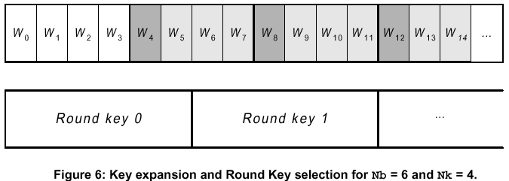
Specification(Cont.)
Key expansion

Slide 5
AES Conceptual Scheme
Plaintext (128 bits)
AES
Key (128-256 bits)
Ciphertext (128 bits)

Slide 6
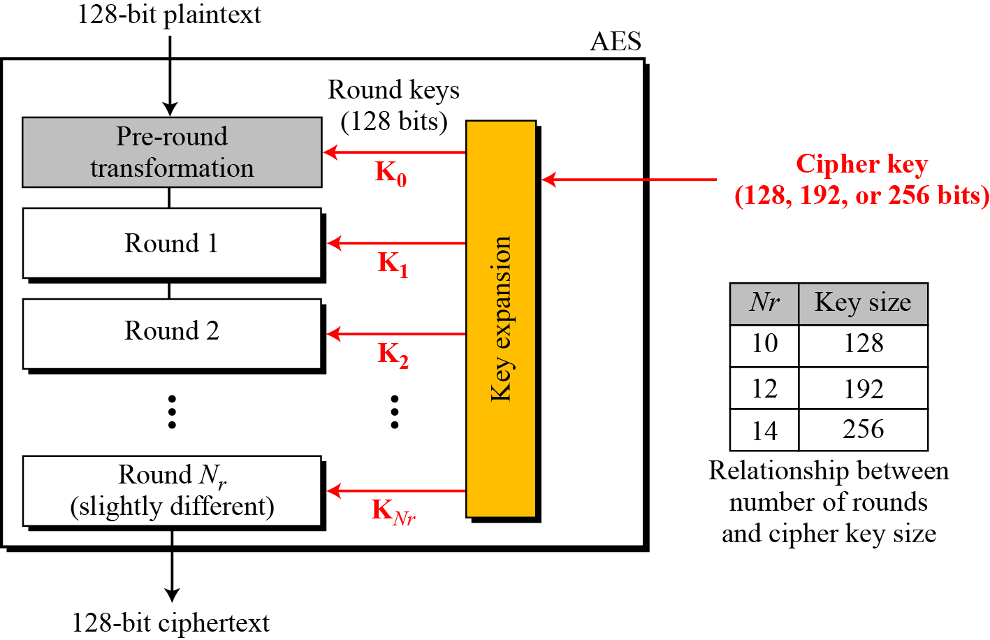
Multiple rounds
Rounds are (almost) identical
  First and last round are a little different
Notes:
The input to the AES encryption and decryption algorithms is a single 128-bit block, depicted in FIPS PUB 197, as a square matrix of bytes .This block is copied into the State array, which is modified at each stage of encryption or decryption. After the final stage, State is copied to an output.
The key is expanded into 44/52/60 lots of 32-bit words (see later), with 4 used in each round.
The data computation then consists of an “add round key” step, then 9/11/13 rounds with all 4 steps, and a final 10th/12th/14th step of byte subs + mix cols + add round key. This can be viewed as alternating XOR key & scramble data bytes operations. All of the steps are easily reversed, and can be efficiently implemented using XOR’s & table lookups.

Slide 7
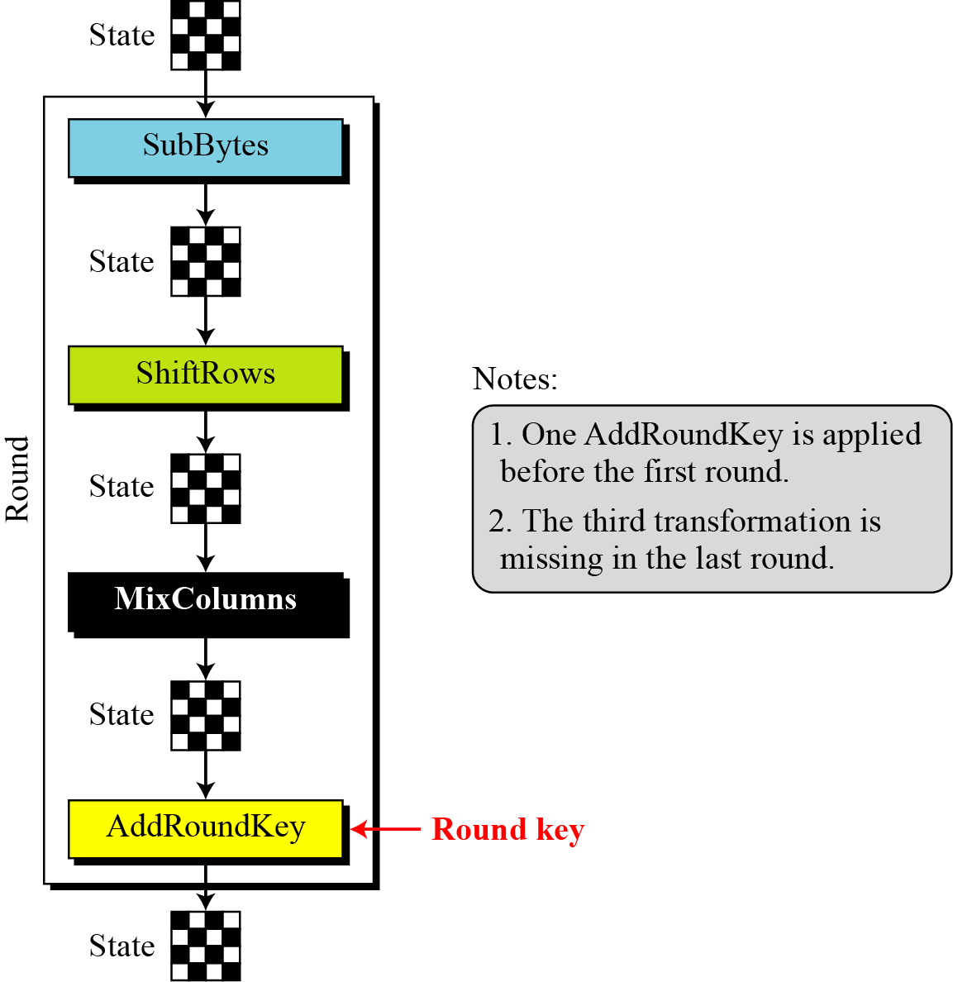
Details of Each Round

Slide 8
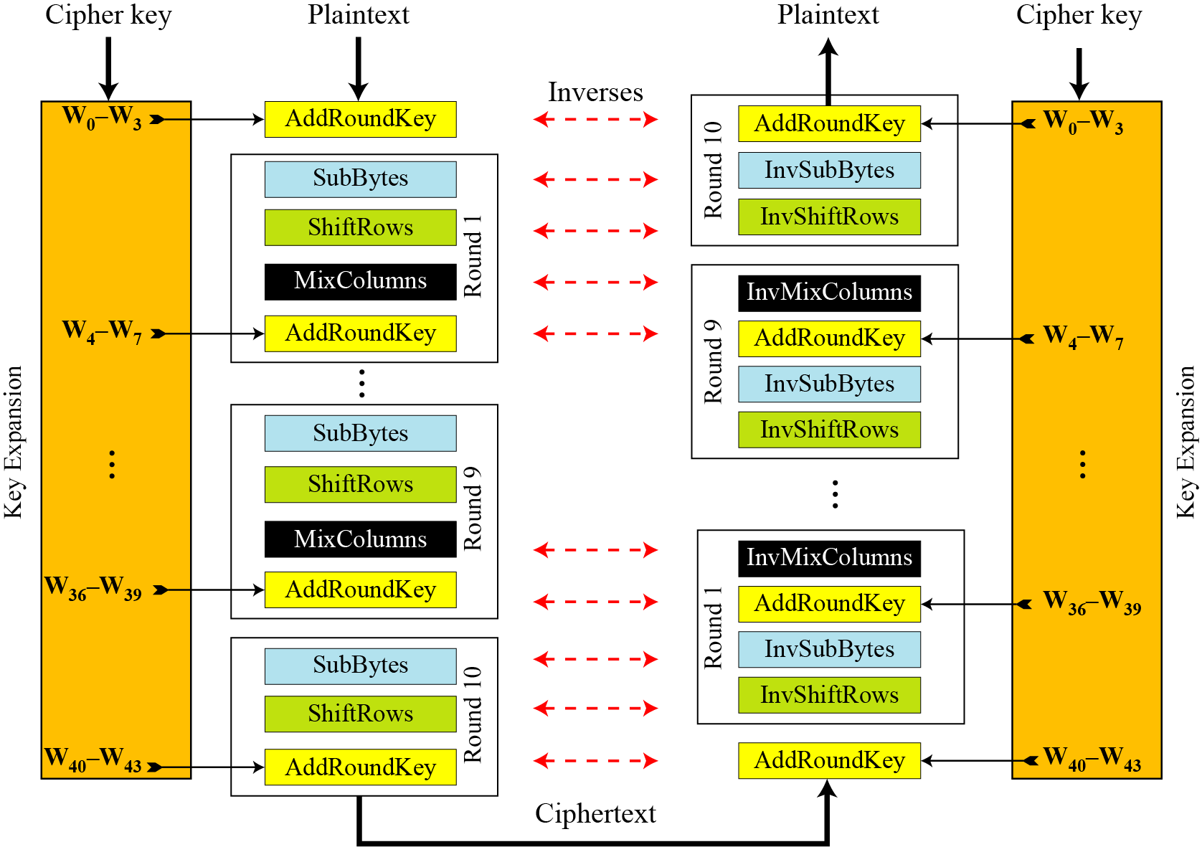
Overall Structure
Notes:
Stallings Figure 5.1 shows the overall structure of AES, as detailed on the previous slide.

Slide 9
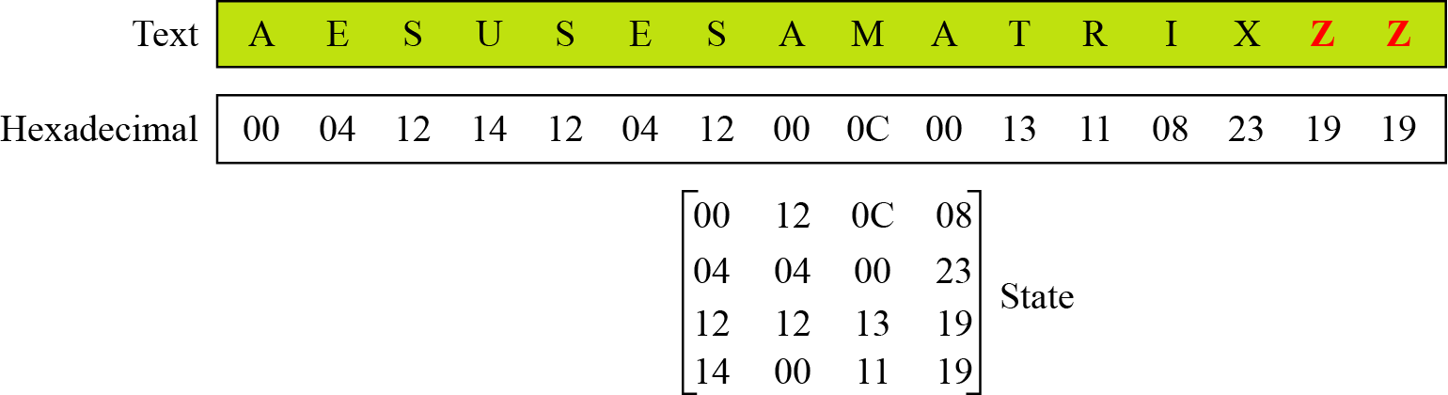
Changing Plaintext to State

Slide 10
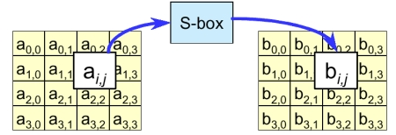
Specification(Cont.)
ByteSub
  Invertible S-Box
  One single S-Box for completely cipher
  High non-linearity

Slide 11
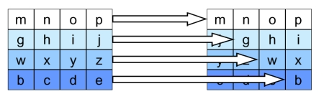
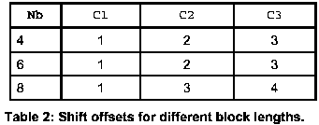
Specification(Cont.)
ShiftRow

Slide 12
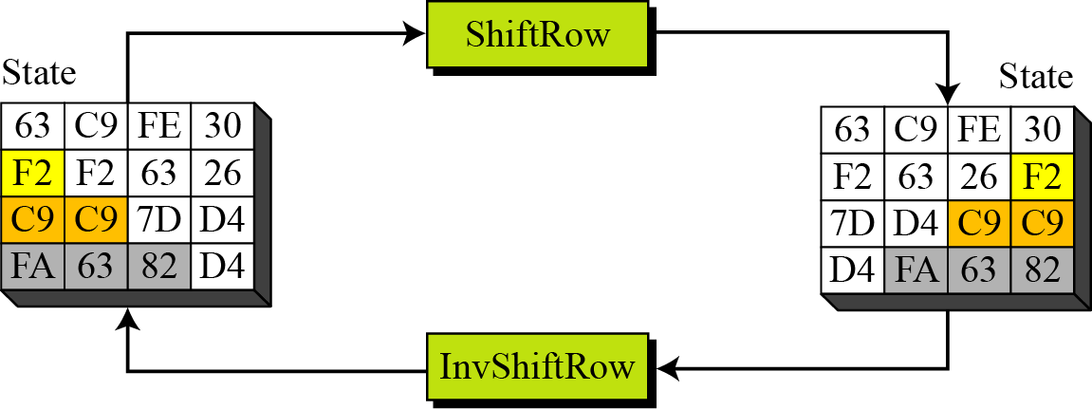
ShiftRows and InvShiftRows
First Row – 0 bytes shift
Second row – 1 bytes shift…. So. On…

Slide 13

MixColumns Scheme
The MixColumns transformation operates at the column level; it transforms each column of the state to a new column.
Notes:
Stalling Figure 5.5b illustrates the Mix Columns transformation.
In practise, you implement Mix Columns by expressing the transformation on each column as 4 equations (Stallings equation 5.4) to compute the new bytes for that column. This computation only involves shifts, XORs & conditional XORs (for the modulo reduction).
The decryption computation requires the use of the inverse of the matrix, which has larger coefficients, and is thus potentially a little harder & slower to implement.
The designers & the AES standard provide an alternate characterisation of Mix Columns, which treats each column of State to be a four-term polynomial with coefficients in GF(2⁸). Each column is multiplied by a fixed polynomial a(x) given in Stallings eqn 5.7. Whilst this is useful for analysis of the stage, the matrix description is all that’s required for implementation.

Slide 14
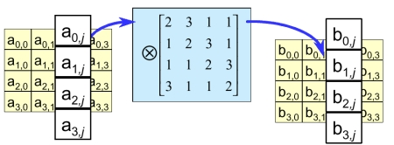
Specification(Cont.)
MixColumn

Slide 15
AddRoundKey
XOR state with 128-bits of the round key
AddRoundKey proceeds one column at a time.
  adds a round key word with each state column matrix
  the operation is matrix addition
Inverse for decryption identical
  since XOR own inverse, with reversed keys
Designed to be as simple as possible
Notes:
Lastly is the Add Round Key stage which is a simple bitwise XOR of the current block with a portion of the expanded key. Note this is the only step which makes use of the key and obscures the result, hence MUST be used at start and end of each round, since otherwise could undo effect of other steps. But the other steps provide confusion/diffusion/non-linearity. That us you can look at the cipher as a series of XOR with key then scramble/permute block repeated. This is efficient and highly secure it is believed.

Slide 16

AddRoundKey Scheme
Notes:
Stallings Figure 5.4b illustrates the Add Round Key stage, which like Byte Substitution, operates on each byte of state independently.

Slide 17

AES Round
Notes:
Can thus now view all the internal details of the AES round, showing how each byte of the state is manipulated, as shown in Stallings Figure 5.3.

Slide 18
AES Security
AES was designed after DES.
Most of the known attacks on DES were already tested on AES.
Brute-Force Attack
  AES is definitely more secure than DES due to the larger-size key.
Statistical Attacks
  Numerous tests have failed to do statistical analysis of the ciphertext
Differential and Linear Attacks
  There are no differential and linear attacks on AES as yet.

Slide 19
Implementation Aspects
The algorithms used in AES are so simple that they can be easily implemented using cheap processors and a minimum amount of memory.
Very efficient
Implementation was a key factor in its selection as the AES cipher
Notes:
AES can also be very efficiently implemented on an 32-bit processor, by rewriting the stage transformation to use 4 table lookups & 4 XOR’s per column of state. These tables can be computed in advance using the formulae shown in the text, and need 4Kb to store.
The developers of Rijndael believe that this compact, efficient implementation was probably one of the most important factors in the selection of Rijndael for AES.

Slide 20
Conclusion
Rijndael has the symmetric and parallel structure.
Rijndael is well adapted to modern processors.
Rijndael is suited for Smart cards

Slide 21
Future Discussion
Strength against known attacks
  Differential cryptanalysis, linear cryptanalysis, and etc.
Weak keys
Application

Slide 22
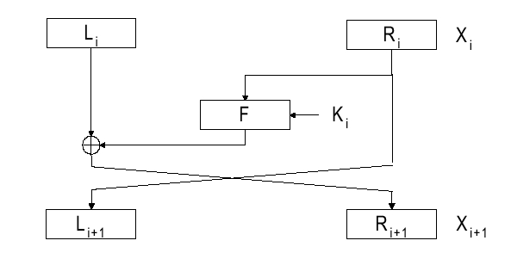
Feistel Structure

Slide 23
Wide Trail Strategy
Linear mixing layer
Non-linear layer
X_{i}
X_{i+1}
Key addition layer

